Slide 1
UNI-CHAIN
A decentralised disaster management solution

Slide 2
The problem
People who donate money does not know if their money was utilised properly.
The different relief camps does not have a proper way of communication to make sure that resources are not in excess.

Slide 3

The solution
A decentralised platform for donating money which is free and visible to all. It can make collection and distribution of money easier.

Slide 4
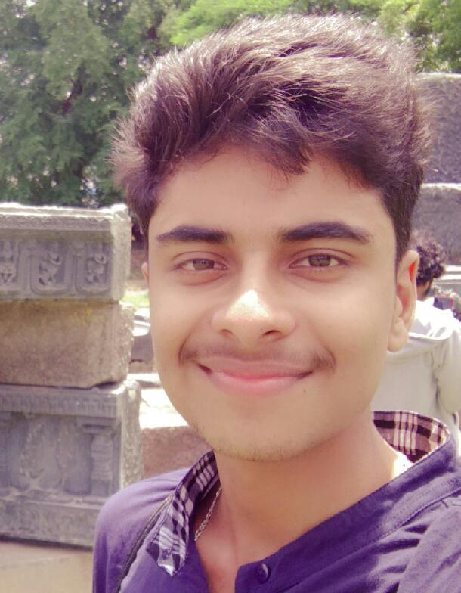
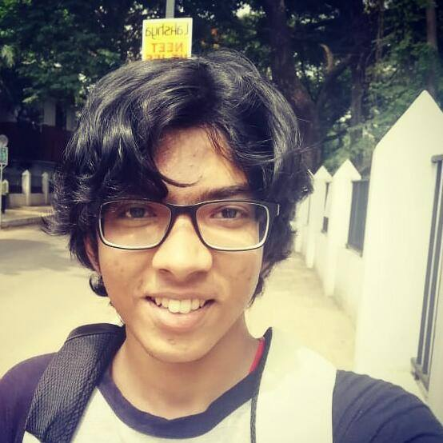
TEAM
Aswinraj K
Sreeram Venkitesh
2nd Year, ECE, Mar Athanasius College of Engineering ark-aswinraj.github.io
2nd Year, ECE, Mar Athanasius College of Engineering fillerInk.github.io

Slide 5
Why a blockchain solution?
A pool of funding visible and accessible to all.
Relief camps which are “smart” – in utilisation of resources.

Slide 6
Future Scope
A platform for Non-Indians and Non-Resident Indians to donate money and make sure that it reaches the deserving hands.
Centres like schools and colleges can register as relief camps beforehand a disaster so that sending supplies once a disaster has happened is relatively easy.

Slide 7

Why fund us? At a time of disaster, action needs to be taken real quick to reduce the casaulties. We provide a simple and fool-proof solution.

